Slide 1
Transactivation Assay:
Tests for the ability of the activated receptor to turn on gene transcription
Estrogen
Compound
Fluoroscein
molecule
Estrogen receptor
Coumarin
molecule
Blue Light
Gal4 transcription factor
β-lactamase
HEK293T
β-lactamase reporter gene
UAS
Green Light
Notes:
Gal4/UAS system
Is a biochemical method used to study gene expression, and it has also been adapted to study receptor chemical-binding functions in vitro in cell culture. ^{Wikipedia}
Gal4 – transcription factor, protein found in fungus
Transcription factor is a protein that controls the rate of transcription of genetic information from DNA to messenger RNA, by binding to a specific DNA sequence. ^{Wikipedia}
UAS – upstream activation sequence
It is distinct from the promoter and increases the expression of a neighboring gene. Due to its essential role in activating transcription, the upstream activating sequence is often considered to be analogous to the function of the enhancer in multicellular eukaryotes.^{Wikipedia}

Slide 2
Estrogen and Androgen Receptor (ER & AR) Binding Assay Using Fluorescence Polarization
Uses a fluorescent labeled molecule bound to the receptor molecule
The ER ligand binding assay uses a recombinant human estrogen receptor (hER) and a fluorescein-labeled estrone derivative as the ligand
The androgen receptor binding assay employs the rat androgen receptor ligand binding domain
The competitor is identified by the hormone (e.g. estradiol) or hormone mimicking compound’s (e.g. Tamoxifin) ability to disrupt the binding of the fluorescent inhibitor molecule

Slide 3
Ligand Binding Assay with Fluorescent Polarization
Fluorescent ligand
Low binding affinity ligand
+
Human estrogen receptor (hER)
+
Recombinant hER
High binding affinity ligand

Slide 4
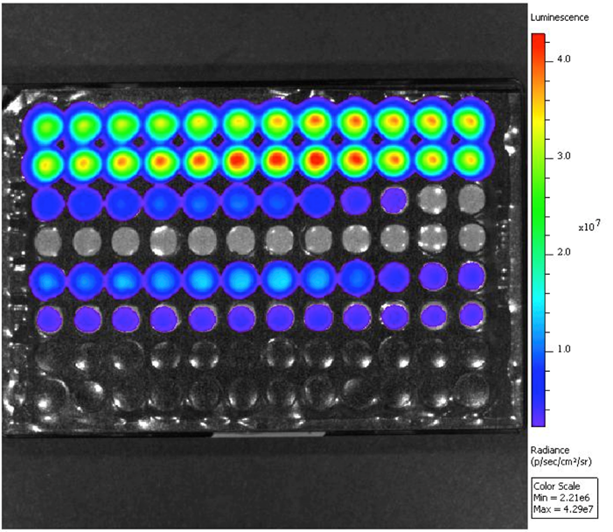
Yeast Based Reporter Gene Assay
Notes:
BLYES test

Slide 5
Bioluminescent Yeast Estrogen & Androgen Screen
Used to detect water’s estrogenic and androgenic activity by promoting a light-generating or bioluminescent response in the yeast strain (Sanserivino et al., 2005)
The yeast cell containing a human estrogen receptor – α gene and constructed bacterial DNA fused with reporter genes required for the bioluminescent reaction.
Luminescence is generated when the yeast cell is dosed with a sample containing estrogen/estrogen-mimicking compounds

